Slide 1

CMPT 470
Thorv 205A
Oct 11, 2019
1:30pm - 2:20pm
SPEAKER DETAILS
Dale Hopkins
Chief Technology Officer

Slide 2
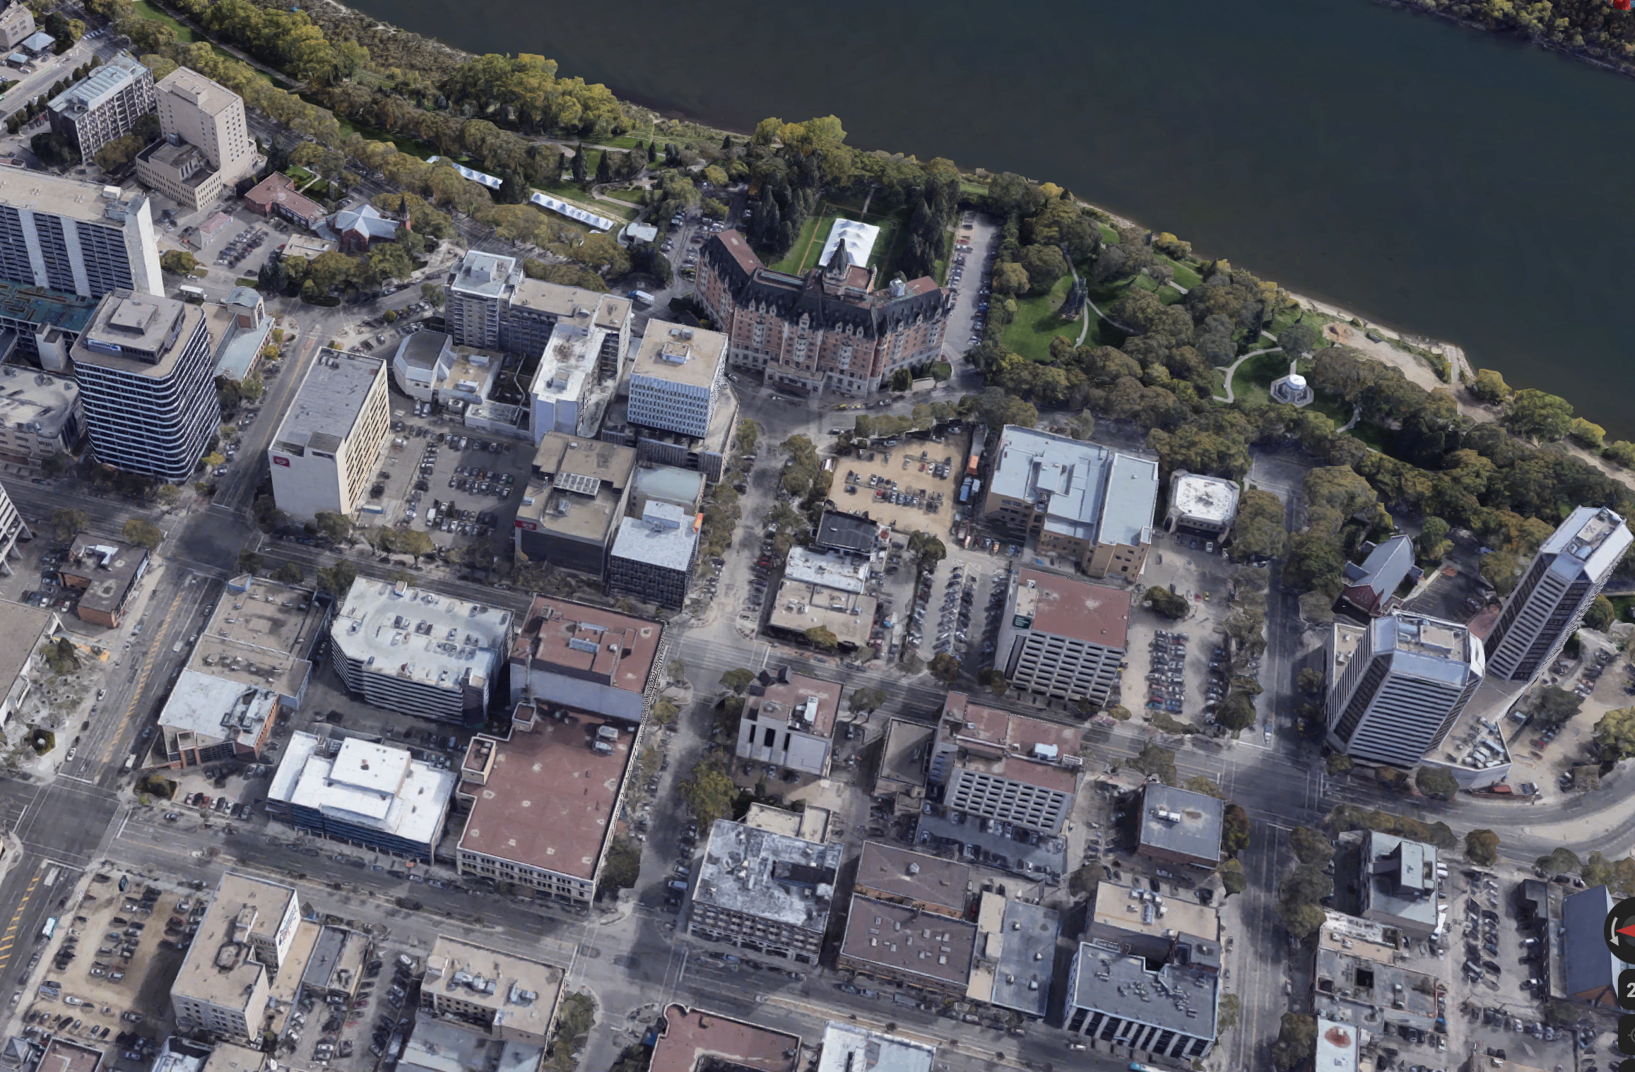

NEW
OLD
Notes:
Logos for copy+paste onto light & white backgrounds

Slide 3
The 12-Factor App
The Agile Manifesto for cloud application development :)
https://www.12factor.net/
Read it Regularly
Each piece takes time and effort to understand
Notes:
Let me know if any of your Partners are interested

Slide 4

Disposability
Optimize Startup Time
Support Graceful Shutdown
Expect Sudden Death
Notes:
Let me know if any of your Partners are interested

Slide 5


At Most Once

Slide 6
Happy Path
1
Worker
Database
2
Queue
3
Worker
4
Notes:
Let me know if any of your Partners are interested

Slide 7
Happy Path
1
4
Worker
Database
2
Queue
3
Worker
Notes:
Let me know if any of your Partners are interested

Slide 8
Happy Path
1
Worker
4
Database
2
Queue
Worker
3
Notes:
Let me know if any of your Partners are interested

Slide 9
Happy Path
2
Worker
4
Database
Queue
3
1
Worker
Notes:
Let me know if any of your Partners are interested

Slide 10
Happy Path
Worker
4
2
Database
Queue
3
Worker
1
Notes:
Let me know if any of your Partners are interested

Slide 11
Happy Path
Worker
4
Database
Queue
3
2
Worker
1
Notes:
Let me know if any of your Partners are interested

Slide 12
Failure

Slide 13
Worker Failure
1
Worker
Database
2
Queue
3
Worker
4
Notes:
Let me know if any of your Partners are interested

Slide 14
Worker Failure
1
4
Worker
Database
2
Queue
3
Worker
Notes:
Let me know if any of your Partners are interested

Slide 15
Happy Path
1
Worker
4
Database
2
Queue
Worker
3
Notes:
Let me know if any of your Partners are interested

Slide 16
Happy Path
2
Worker
4
Database
Queue
3
1
Worker
Notes:
Let me know if any of your Partners are interested

Slide 17
Worker Failure
2
Worker
4
☠️
Database
Queue
3
Worker
1
Notes:
Let me know if any of your Partners are interested

Slide 18
Worker Failure
Worker
4
☠️
Database
Queue
3
Worker
1
Notes:
Let me know if any of your Partners are interested

Slide 19
At Least Once

Slide 20
Happy Path
1
Worker
Database
2
Queue
3
Worker
4
Notes:
Let me know if any of your Partners are interested

Slide 21
Happy Path
1
4
Worker
Database
2
Queue
3
3
Worker
4
Notes:
Let me know if any of your Partners are interested

Slide 22
Happy Path
1
Worker
4
Database
2
Queue
3
Worker
4
3
Notes:
Let me know if any of your Partners are interested

Slide 23
Happy Path
4
1
Worker
4
Database
2
Queue
3
Worker
3
Notes:
Let me know if any of your Partners are interested

Slide 24
Happy Path
1
2
Worker
4
Database
2
Queue
3
1
Worker
Notes:
Let me know if any of your Partners are interested

Slide 25
Happy Path
1
Worker
4
2
Database
2
Queue
3
Worker
1
Notes:
Let me know if any of your Partners are interested

Slide 26
Happy Path
2
Worker
4
Database
Queue
3
2
Worker
1
1
Notes:
Let me know if any of your Partners are interested

Slide 27
Happy Path
Worker
4
Database
Queue
3
2
Worker
1
Notes:
Let me know if any of your Partners are interested

Slide 28
Happy Path
Worker
4
Database
Queue
3
2
Worker
1
Notes:
Let me know if any of your Partners are interested

Slide 29
Failure

Slide 30
Worker Fails to Process
1
Worker
Database
2
Queue
3
Worker
4
Notes:
Let me know if any of your Partners are interested

Slide 31
Worker Fails to Process
1
4
Worker
Database
2
Queue
3
3
Worker
4
Notes:
Let me know if any of your Partners are interested

Slide 32
Worker Fails to Process
1
Worker
4
Database
2
Queue
3
Worker
4
3
Notes:
Let me know if any of your Partners are interested

Slide 33
Worker Fails to Process
4
1
Worker
4
Database
2
Queue
3
Worker
3
Notes:
Let me know if any of your Partners are interested

Slide 34
Worker Fails to Process
1
2
Worker
4
Database
2
Queue
3
1
Worker
Notes:
Let me know if any of your Partners are interested

Slide 35
Worker Fails to Process
2
1
Worker
4
☠️
Database
2
Queue
3
Worker
1
Notes:
Let me know if any of your Partners are interested

Slide 36
Worker Fails to Process
Worker
4
☠️
Database
2
Queue
3
Worker
1
1
Notes:
Let me know if any of your Partners are interested

Slide 37
Worker Fails to Process
Worker
4
☠️
Database
2
Queue
3
Worker
1
Notes:
Let me know if any of your Partners are interested

Slide 38
Worker Fails to Process
Worker
4
☠️
Database
2
Queue
3
2
Worker
1
Notes:
Let me know if any of your Partners are interested

Slide 39
Happy Path
Worker
4
☠️
Database
2
Queue
3
Worker
2
1
Notes:
Let me know if any of your Partners are interested

Slide 40
Worker Fails to Process
Worker
4
☠️
Database
Queue
3
2
Worker
1
2
Notes:
Let me know if any of your Partners are interested

Slide 41
Worker Fails to Process
Worker
4
☠️
Database
Queue
3
2
Worker
1
Notes:
Let me know if any of your Partners are interested

Slide 42
Failure

Slide 43
Worker Fails to Expire Lease
1
Worker
Database
2
Queue
3
Worker
4
Notes:
Let me know if any of your Partners are interested

Slide 44
Worker Fails to Expire Lease
1
4
Worker
Database
2
Queue
3
3
Worker
4
Notes:
Let me know if any of your Partners are interested

Slide 45
Worker Fails to Expire Lease
1
Worker
4
Database
2
Queue
3
Worker
4
3
Notes:
Let me know if any of your Partners are interested

Slide 46
Worker Fails to Expire Lease
4
1
Worker
4
Database
2
Queue
3
Worker
3
Notes:
Let me know if any of your Partners are interested

Slide 47
Worker Fails to Expire Lease
1
2
Worker
4
Database
2
Queue
3
1
Worker
Notes:
Let me know if any of your Partners are interested

Slide 48
Worker Fails to Expire Lease
1
Worker
4
2
Database
2
Queue
3
Worker
1
Notes:
Let me know if any of your Partners are interested

Slide 49
Worker Fails to Expire Lease
Worker
4
☠️
Database
2
Queue
3
2
Worker
1
1
Notes:
Let me know if any of your Partners are interested

Slide 50
Worker Fails to Expire Lease
Worker
4
☠️
Database
2
Queue
3
2
Worker
1
Notes:
Let me know if any of your Partners are interested

Slide 51
Worker Fails to Expire Lease
Worker
4
☠️
Database
2
Queue
3
2
2
Worker
1
Notes:
Let me know if any of your Partners are interested

Slide 52
Worker Fails to Expire Lease
Worker
4
☠️
Database
2
Queue
3
2
Worker
2
1
Notes:
Let me know if any of your Partners are interested

Slide 53
Worker Fails to Expire Lease
Worker
4
☠️
Database
Queue
3
2
2
Worker
1
2
Notes:
Let me know if any of your Partners are interested

Slide 54
Worker Fails to Expire Lease
Worker
4
☠️
Database
Queue
3
2
2
Worker
1
Notes:
Let me know if any of your Partners are interested

Slide 55
Idempotency
Functions that can be run one or more times on the same inputs and generate the same result.
Unique constraints are key
Notes:
Let me know if any of your Partners are interested

Slide 56
Example
func mutateSomeData(inFile string, ops ...string) (error) {
f, err := os.Open(inFile)
if err != nil {
return err
}
defer f.Close()
obj := &SomeObject{}
err = json.NewDecoder(f).Decode(obj)
if err != nil {
return err
}
for _ = range ops {
//TODO: Make object modifications
}
if err = f.Truncate(0); err != nil {
return err
}
if _, err = f.Seek(0, io.SeekStart); err != nil {
return err
}
err = json.NewEncoder(f).Encode(obj)
return err
}
Notes:
Logos for copy+paste onto light & white backgrounds

Slide 57
Improved Once
func mutateSomeData2(inFile string, ops ...string) (string, error) {
f, err := os.Open(inFile)
if err != nil {
return "", err
}
defer f.Close()
obj := &SomeObject{}
err = json.NewDecoder(f).Decode(obj)
if err != nil {
return "", err
}
for _ = range ops {
//TODO: Make object modifications
}
name := fmt.Sprintf("%s.json", uuid.New().String())
outf, err := os.Create(name)
if err != nil {
return "", err
}
defer outf.Close()
err = json.NewEncoder(outf).Encode(obj)
return name, err
}
Notes:
Logos for copy+paste onto light & white backgrounds

Slide 58
Improved Twice
func mutateSomeData3(inFile string, outFile string, ops ...string) error {
f, err := os.Open(inFile)
if err != nil {
return err
}
defer f.Close()
obj := &SomeObject{}
err = json.NewDecoder(f).Decode(obj)
if err != nil {
return err
}
for _ = range ops {
//TODO: Make object modifications
}
outf, err := os.Create(outFile)
if err != nil {
return err
}
defer outf.Close()
err = json.NewEncoder(outf).Encode(obj)
return err
}
Notes:
Logos for copy+paste onto light & white backgrounds

Slide 59
Improved Thrice
func mutateSomeData4(in io.Reader, out io.Writer, ops ...string) error {
obj := &SomeObject{}
err := json.NewDecoder(in).Decode(obj)
if err != nil {
return err
}
for _ = range ops {
//TODO: Make object modifications
}
err = json.NewEncoder(out).Encode(obj)
return err
}
Notes:
Logos for copy+paste onto light & white backgrounds

Slide 60






Pipeline Processing
Organize work into small idempotent pieces
Notes:
Let me know if any of your Partners are interested

Slide 61





Dale Hopkins
Chief Technology Officer, Vendasta
dhopkins@vendasta.com
306.262.6599
@dalehopkins
vendasta.com

